Slide 1
E-Commerce Website for Automotive Parts
Name : Jishnu Nambiar (Enrollment No : EBEON0322578300)
Name :- Sudhir Kumbhar (Enrollment No : EBEON0322584185)
Name: Sateeswarbabu Katem (Enrollment No :EBEON0322571885)
Name: Ranjini Devi.R (Enrollment No : EBEON0322579232)
Name: Sanjai.S (Enrollment No : EBEON0322574368)
Guided by :
Mr. Vardharajan

Slide 2
Introduction
Auto Parts plus is an user friendly ecommerce website which provides users an option to buy any automotive parts for their vehicle from online, within few steps.
As an admin you will be able to add your on categories and product in the website which will be displayed to the user for buying.
We have also included an online payment option which will help user to pay for the products online itself.

Slide 3
Software and Hardware Requirements
Software Requirements
Eclipse IDE
Programming language- Java, Spring Boot.
JDK 17
Frontend - HTML, CSS, Bootstrap
Database - MySQL
Hardware Requirements
Processor - Ryzen 5
Speed - 1.8GHz
RAM - 4GB (minimum)
Hard disk- 50GB

Slide 4
E-Commerce Website for Automotive Parts
Modules:
Homepage
Login and Registration
Shop
Cart
Payment
Admin Module
Chatbot

Slide 5
E-Commerce Website for Automotive Parts
Modules and Submodules
Homepage
Navigation bar to redirect to different page.
Login and Registration
SSO (Single Sign on)
Security Configuration
Role Based Login
Logout
Encrypted Password
Databases for user, roles, user_roles

Slide 6
Continued...
Goal of module:
Homepage is the first page of our website which has a navigation bar to redirect the user to different pages of the website.
Login and Registration is necessary if the user wants to buy the product. We have also Included SSO(Single Sign On) which makes it easier to log onto our website.

Slide 7
Homepage (1st Module)
Definition:
Homepage is a welcome page of the website from where a user can redirect or move to different pages. It's a responsive webpage with attractive design.
Sub module details :
Navigation Bar which has a connection with remaining web pages like home, login, shop, cart and logout. After login you can also see your name and a logout button on the navigation bar.
Module Interconnection details :
Here the navigation bar is present throughout the website so it is connected to homepage, login page, shop page and cart page.

Slide 8
Login and Registration (2nd Module)
Definition :
Login and Registration is essential for any website. While registering user has to enter first name, last name, email and password. For login user has to enter the same email and password used while registering.
Sub module details :
SSO - Single Sign On(SSO) is an identification method that enables users to log in to multiple applications and websites with one set of credentials. Here we have applied sign in with google for easy access to the user.
Security Configuration - We have applied the security on overall website where the user will only have permission to shop and signup page without the sign in. No access to admin page either. There is configuration of oauth for SSO, which receives a token and helps the user to login or sign up with the website.

Slide 9
Continued...
Sub module details :
Role Based Login : This website has a admin and user page so we have used a role based login method so that user will not be able to access the admin page. Here we have manually entered only the admin credentials in the database for role based login.
Logout - Logout is connected with the security configuration. When a user logs into the website then in the navigation bar he will get a logout button which will help him to logout of the site.
Encrypted Password - Website stores the user password in encrypted format. We have implemented this for the security purpose, so that the admin or anyone else will not be able the use the user password.

Slide 10
Continued...
Sub module details
Database for users, roles, user_role - These tables are created with the MySQL Database using hibernate. Users table is used to store the data while registration and to verfiy the credential while login. Roles table has to roles which is admin role and user role. user_role is many to many table which has a FOREIGN KEY of users and roles table.

Slide 11
Continued...
users table
id | email | firstname | lastname | password
1 | admin@gmail.com | admin | one | $2a$10$moTjfAVBJ
2 | jishnu@gmail.com | Jishnu | Nambiar | $2a$10$S3QG2F1Ut
roles table
user_role table
id | name
1 | ROLE_ADMIN
2 | ROLE_USER
User_id | Role_id
1 | 1
1 | 2
2 | 2

Slide 12
Project overview
.
Admin
User Details
Add Category
Login
Add Product
Logout
Homepage
Shop
Chatbot
Payment
View Product
Add To Cart
Checkout

Slide 13
Tech architecture
1.)Data JPA Security
2.)Oauth2-Client
3.)Thymeleaf
4.)DevTools
5.)Web
1.)HTML
2.)CSS
3.)JavaScript
4.)BootStrap
1.)Java
2.)Spring Boot
3.)Hibernate concepts
Spring Boot
Browser
FrontEnd
BackEnd
Hibernate
MySQL
1.)Object Persistence
2.)Mapping with POJO
3.)Database Connection
1.)DDL
2.)DML
3.)DCL
4.)TCL

Slide 14
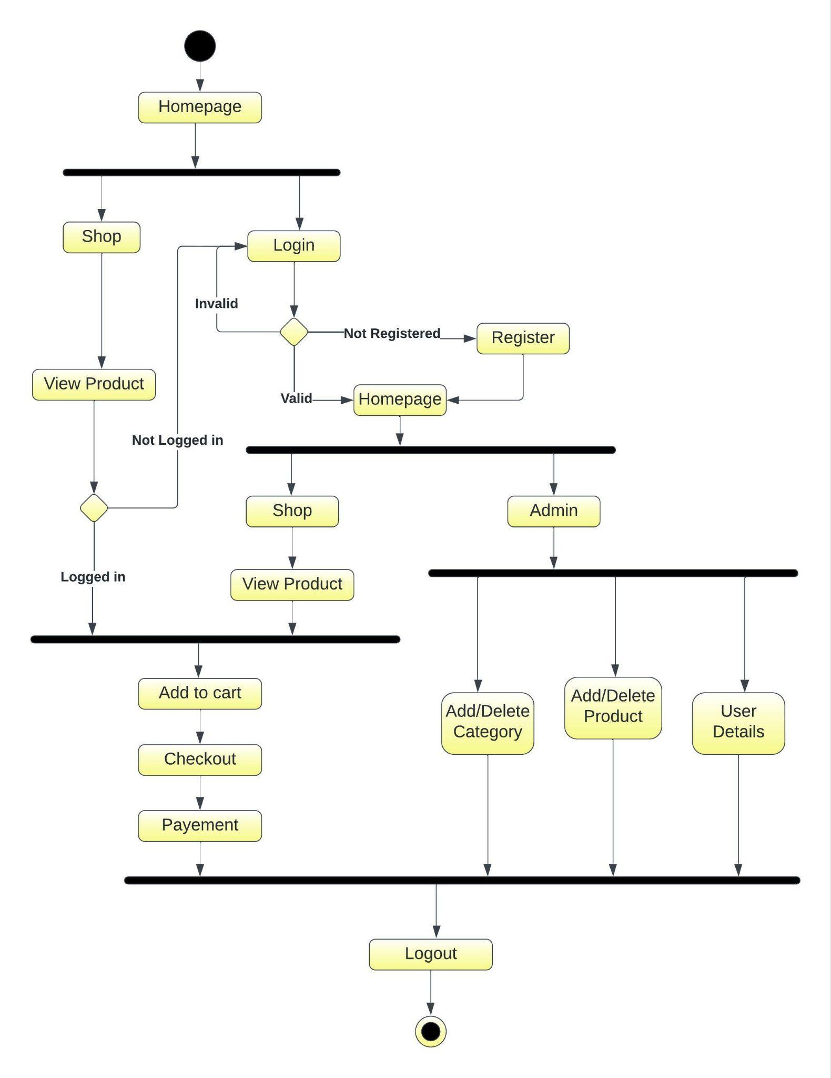
Activity diagram

Slide 15
Challenging issues
Registration error was faced. Error in inserting the value into user table. This error was faced due to mismatch in variable name, I resolved it by naming it properly.
Login page faced an error of not redirecting to the homepage. This error was faced due to unnecessary or wrong references to css and js files. This error was resolved by giving the proper path to that specific files.

Slide 16
Testing
Testing Module | Expected Result | Pass/Fail
1. Registration | Accept all the credentials and store it in the database. | Pass
2. Login | Get logged in with the credentials mentioned during registration. | Pass
3. Logout | User begin able to logout of the website. | Pass
4. Role Based Login | Able to access admin module only if logged in with admin credentials. | Pass
5. Single Sign On | Able to Sign up with google account. | Pass
6. Password encryption | Storing users encrypted password in the database. | Pass

Slide 17
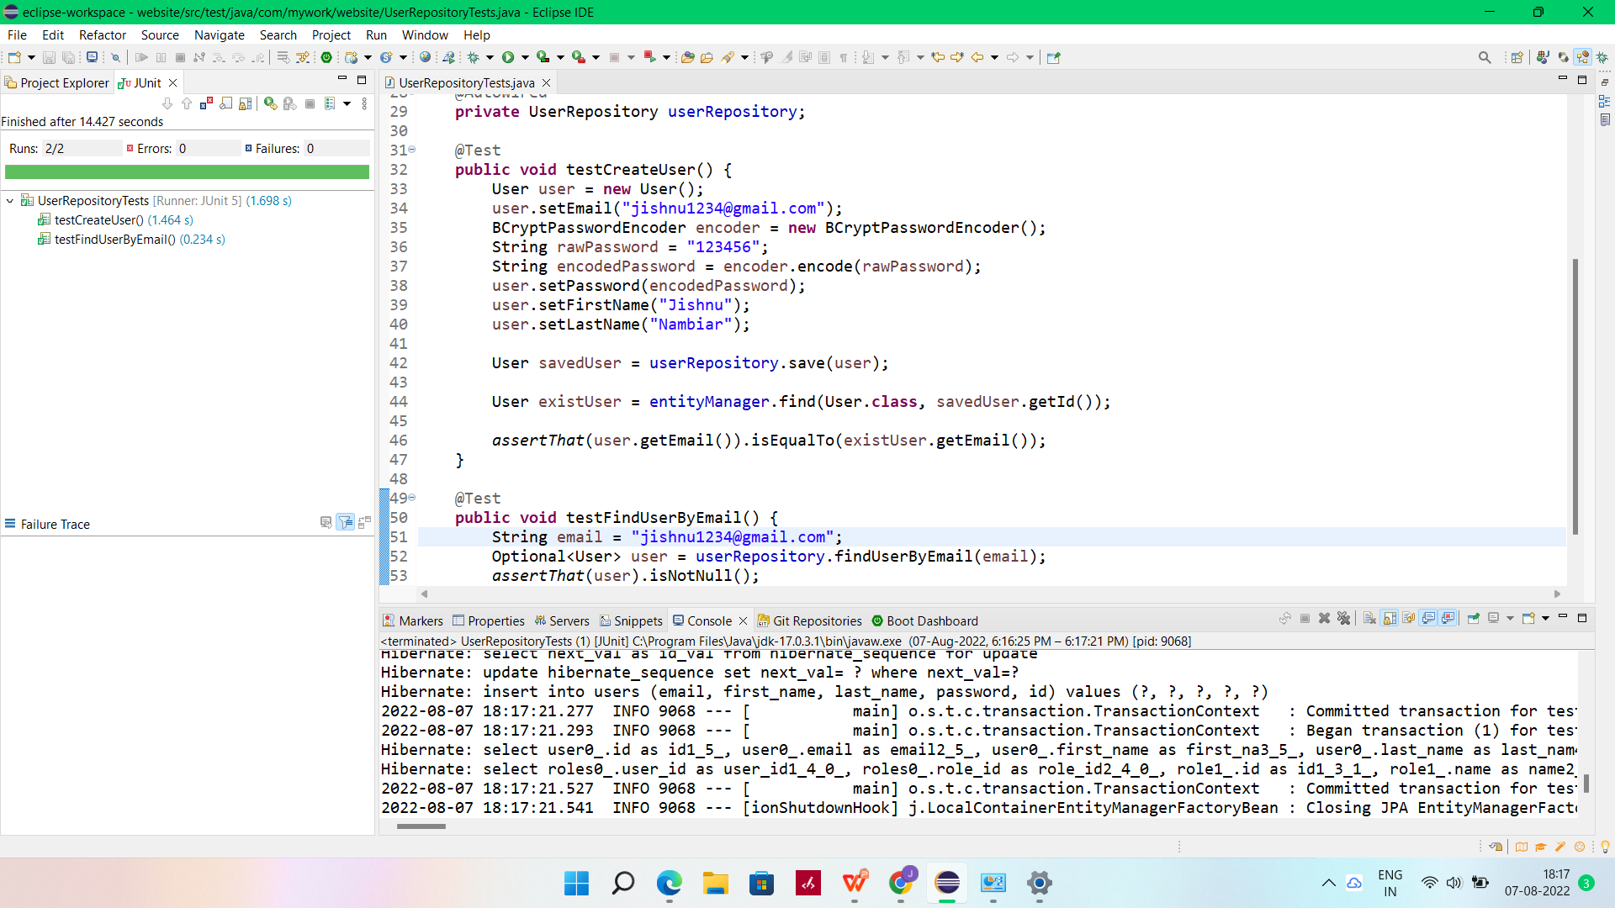
Continued...
Junit has been used for testing the registration and login validation.

Slide 18
Features about the module
Login and Registration module has a SSO feature, which helps in easy sign in with the website. With help of SSO while registering or login user don’t have to waste their time by entering each and every details.
The webpages have amazing transition effect to it.
It has a user friendly interface, where the users will find it easy to use.

Slide 19
Future enhancement
To add Sell product option, where user will also be able to sell their own products.
Add more Single Sign On links like facebook, twitter, etc.
Include stock management.
User profile including orders history.

Slide 20
Quality improvement task
Approached Testing :
Junit and basic validations.
DevOps tools:
MySQL Workbench, Github, Maven
UI approach
HTML, CSS, Bootstrap.

Slide 21
Conclusion
In this project we have built an ecommerce website specially designed for automotive parts. With online payment and may more facilities.
Which has user friendly interface for easy use purpose.
We have implemented the CRUD operations with hibernate and spring boot for easy use of the project.
With this we conclude that this project has almost fulfilled all the basic necessities of an ecommerce website.

Slide 22
THANK YOU
Presented By :
Jishnu Nambiar

